Slide 1
Culturally Preferred Foods
Sourcing & Distribution
Prepared for Cumberland County Food Security Coalition Council Meeting
Access to Culturally Preferred Foods
January 19, 2022

Slide 2
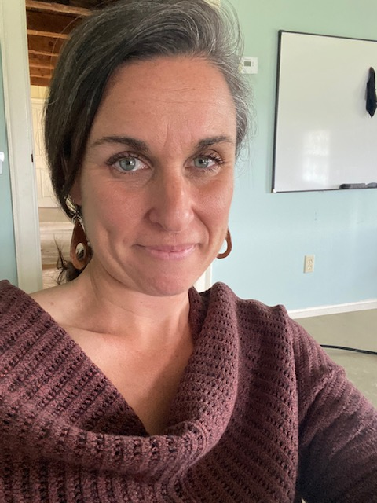
Presented by:
Kay Gray
Director of Sourcing
Khadija Ahmed Community Impact
Manager
Nancy Perry Senior Sourcing Manager
Meg Taft Director of
Equity, Diversity & Inclusion

Slide 3
Overview
04 Understanding the Need
05 Foods we are Sourcing
06 Sourcing Strategies
07 Distribution Strategies
08 Gaps, Challenges & Opportunities
09 Contact Information

Slide 4
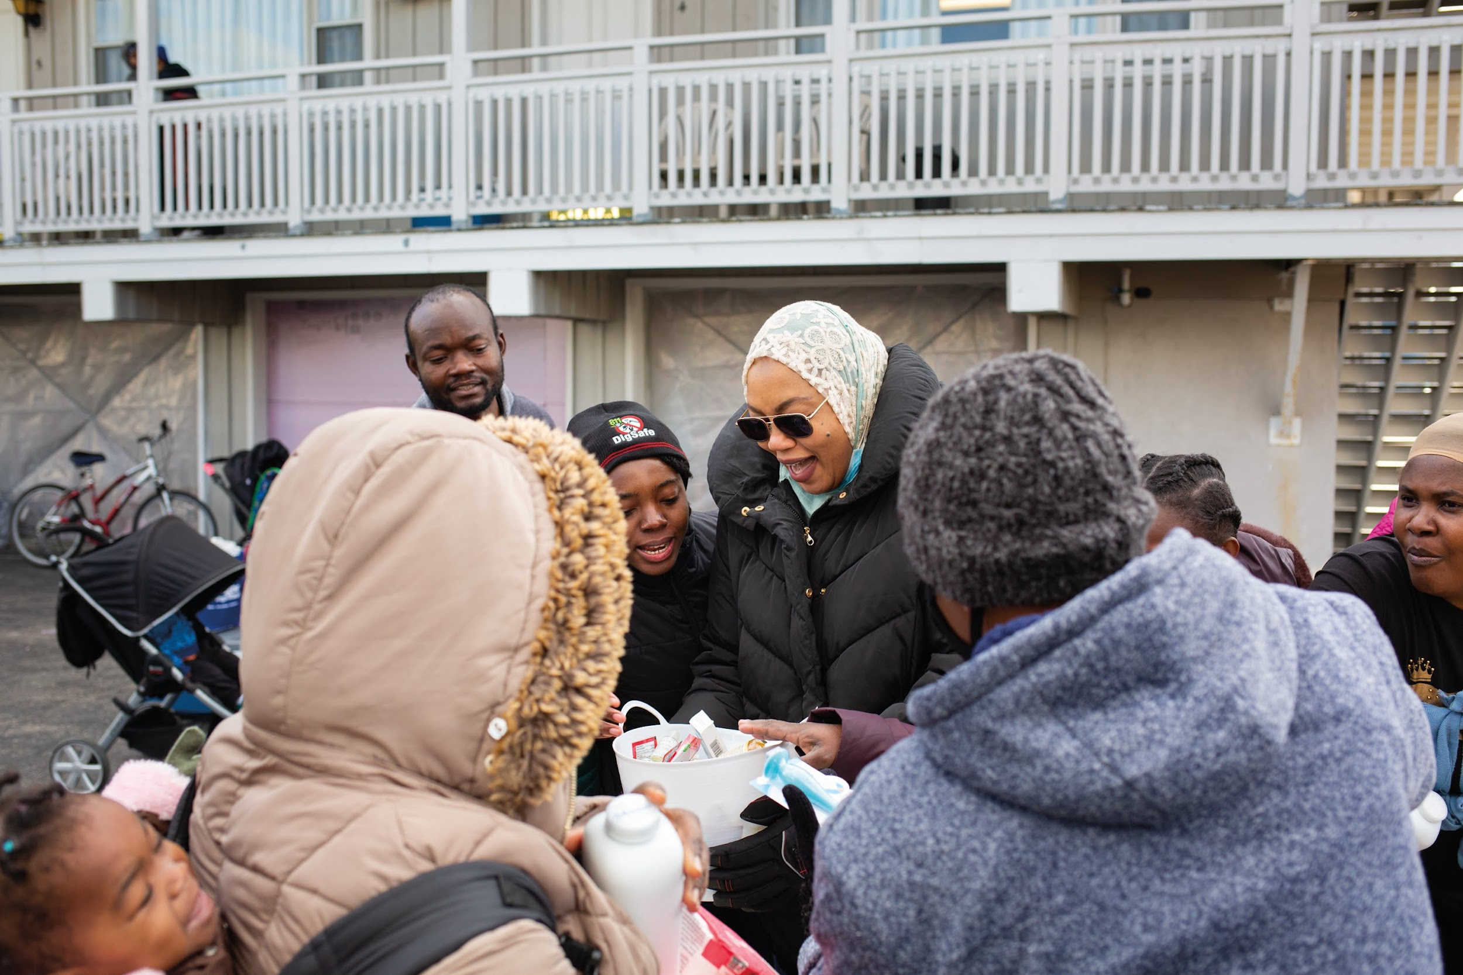
Understanding the Need
Leveraging personal relationships and building new relationships within communities
Staying informed and in connection with community based partners
Reviewing Ethnic Needs Community Reports
Nutrition & Procurement Team
Notes:
Community Based Orgs we are connecting with: MIRC, MEIRS, Catholic Charities, Wayside Food Programs, Preble Street, Network Partners
Community Reports that have informed our sourcing: PPH Minority Health Program Report: Ethnic Needs for French and Lingala communities, 2021 Wayside Food Program focus group reports

Slide 5
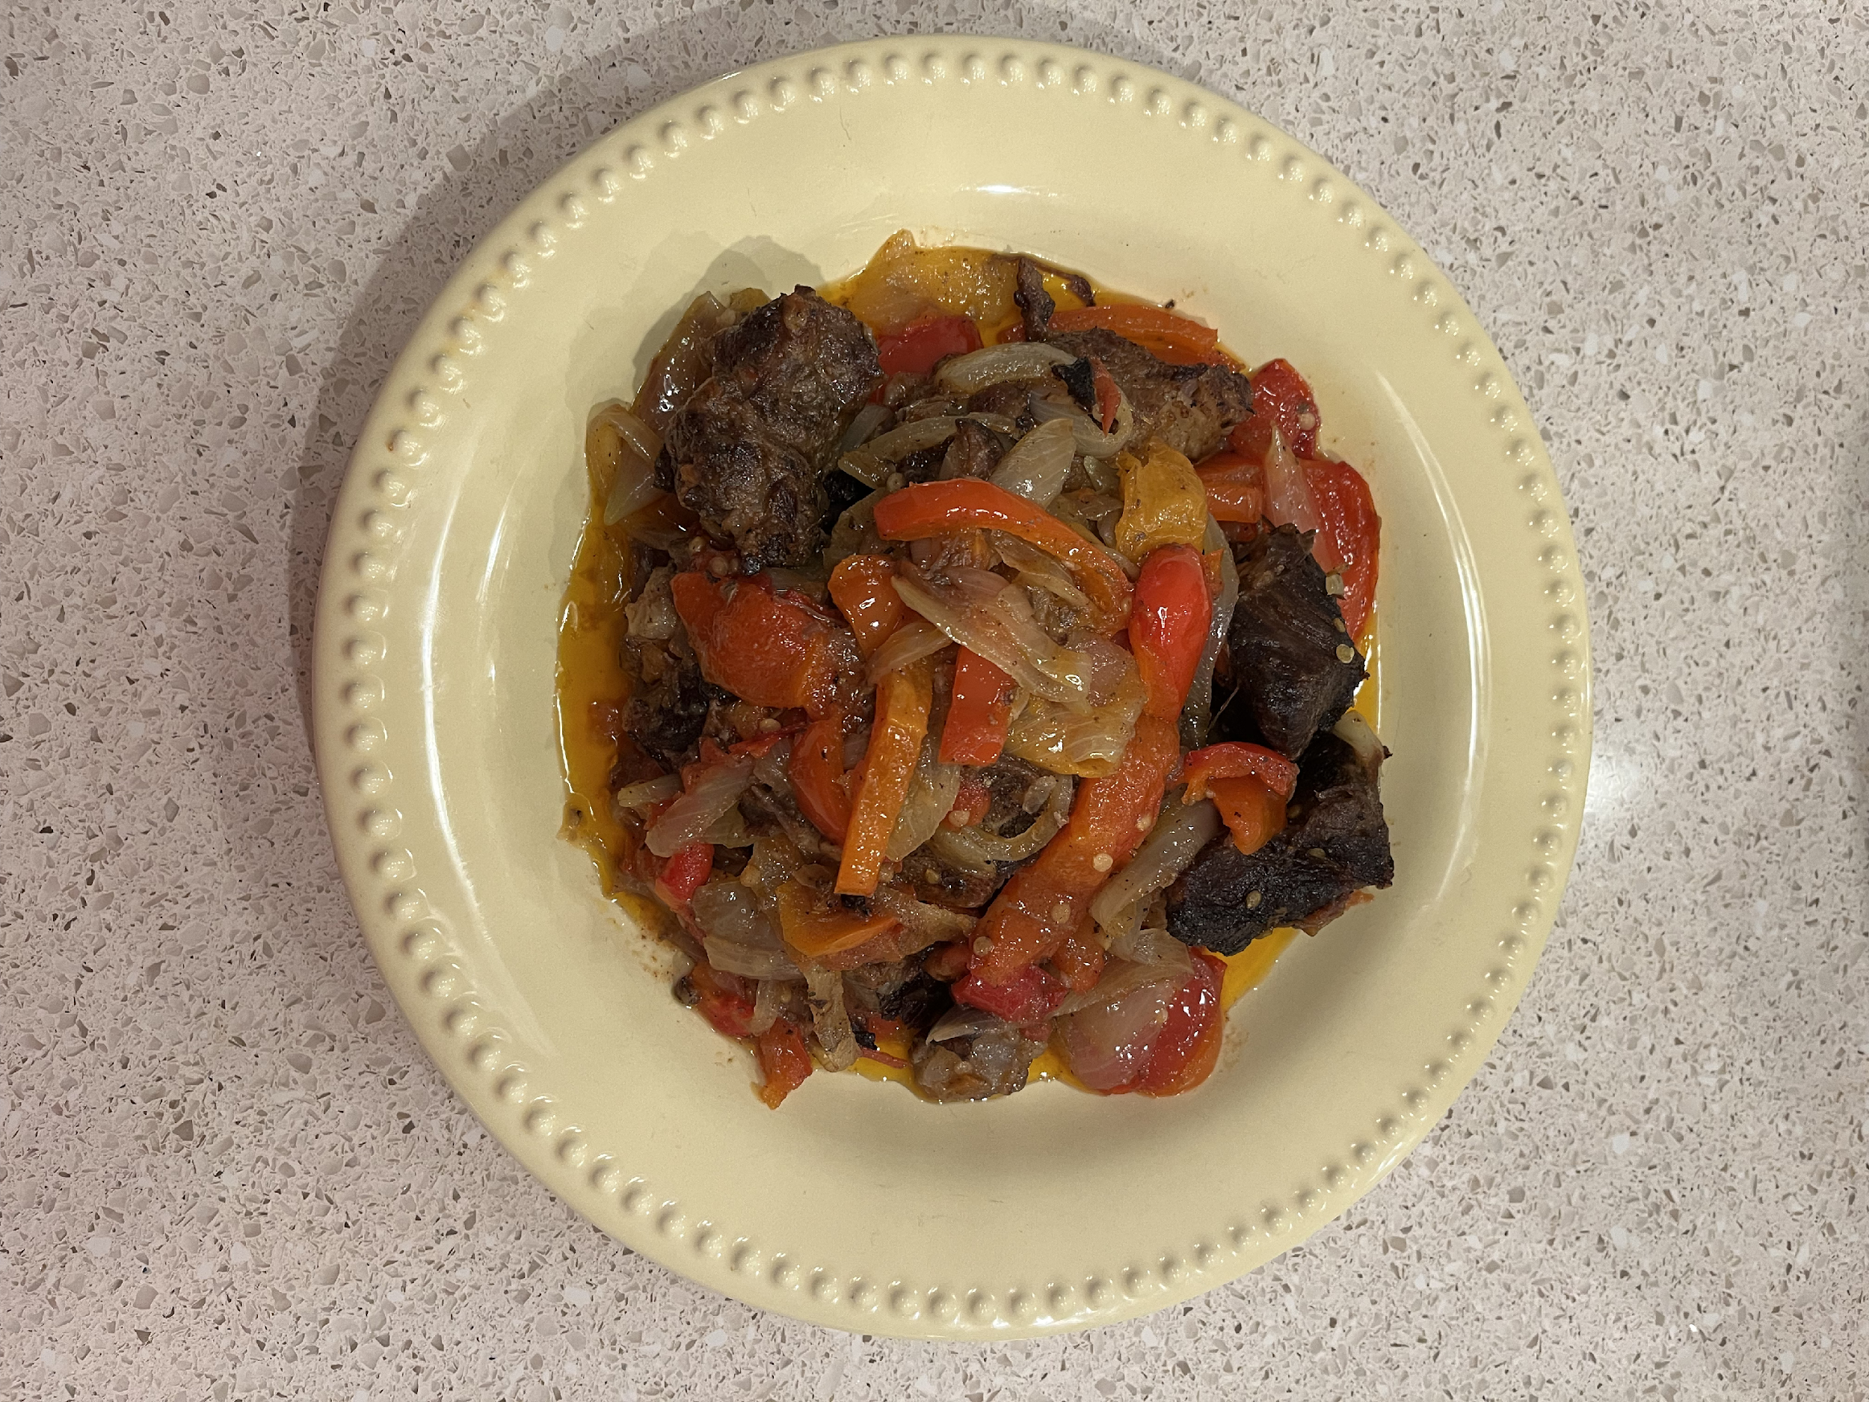
Food We are Sourcing
Halal Meats
Ground beef
Whole Chickens
Rabbit stew meat
Goat stew meat
Ground chicken
Lamb stew meat
Beef stew meat
Photo and Cooking Credit: Khadija Ahmed
‹#›

Slide 6
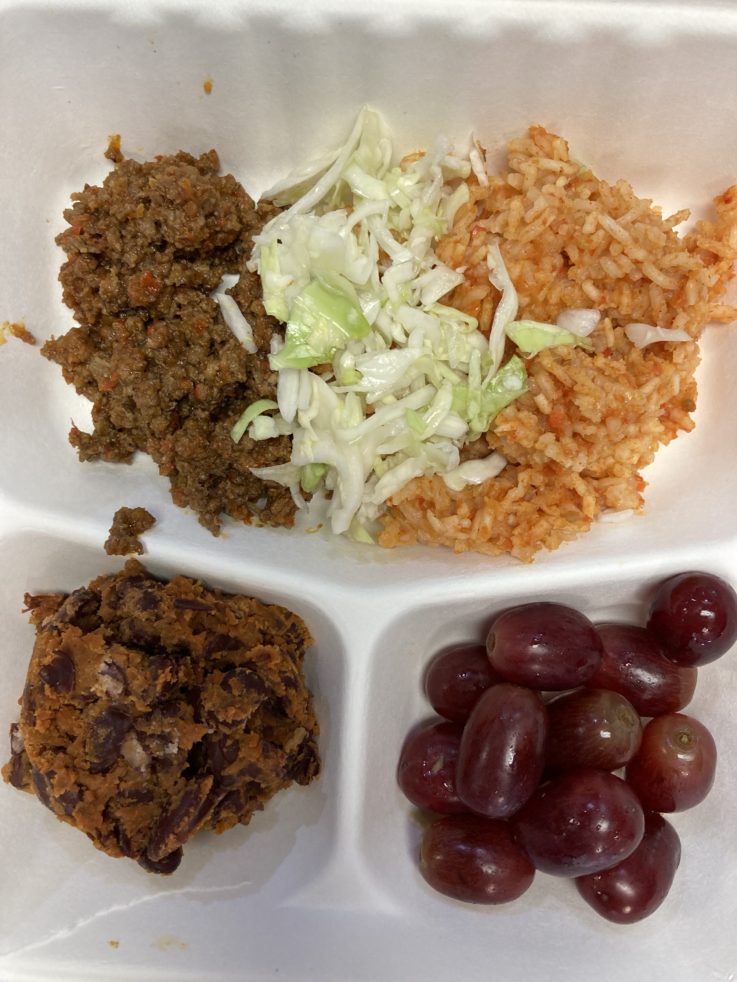
Food We are Sourcing
Non-Meat Products
Aho Bara Rice Fresh garlic
Lentils Cinnamon
Cornmeal Cumin
Almonds Curry Powder
Pistachios
Walnuts
Dried Fruit (apricots)
Eggs
Fresh milk
Okra
Green Beans (canned)
Potatoes
Carrots
Photo Credit: Khadija Ahmed, Westbrook School Cultural Meals Program
‹#›

Slide 7
Sourcing
Strategies
Existing and new vendors
Prioritizing high quality protein sources
Piloting wide variety of halal meets to determine demand
Listening to community members & partners
Align culturally preferred foods with the Food Bank’s Never Out strategy
Mainers Feeding Mainers partnerships & expansion
Community Redistribution Fund
Notes:
MFM partnerships: Somali Bantu Community, Liberation Farms, Mic Mac Farms, New Roots Cooperative, Cultivating Community
Community Redistribution Fund Partners:

Slide 8
Distribution
Strategies
Food Bank partner network
Mainers Feeding Mainers
Pop up distributions with community partners
Muslim based Food Pantries
Emergency Funding for resettlement efforts
Community Redistribution Fund Partners
Notes:
Muslim led food pantry in Lewiston is Masjid Al Salaam
Muslim led food pantry in Portland is currently in process, Khadija is facilitating/organizing

Slide 9
Gaps, Challenges & Opportunities
No halal meat processor currently in ME
Growing season and climate
Current distribution network is limited based on contractual agreements with Feeding America
Investing in BIPOC owned/led food processing and production businesses
Notes:
Prospective Halal Meat Processers in ME- Ummah Farms, Five Pillar in Unity, Liberation Farms – Somali Bantu Community Association
Cooperative Buying: Example of Westbrook Schools ordering- could others join in this effort for some cooperative purchasing?

Slide 10
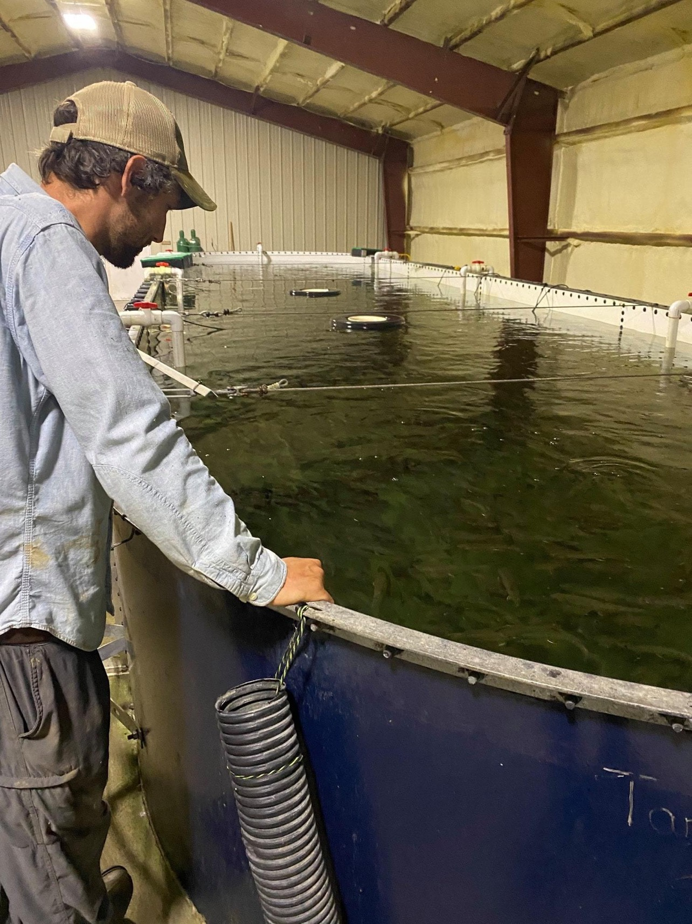
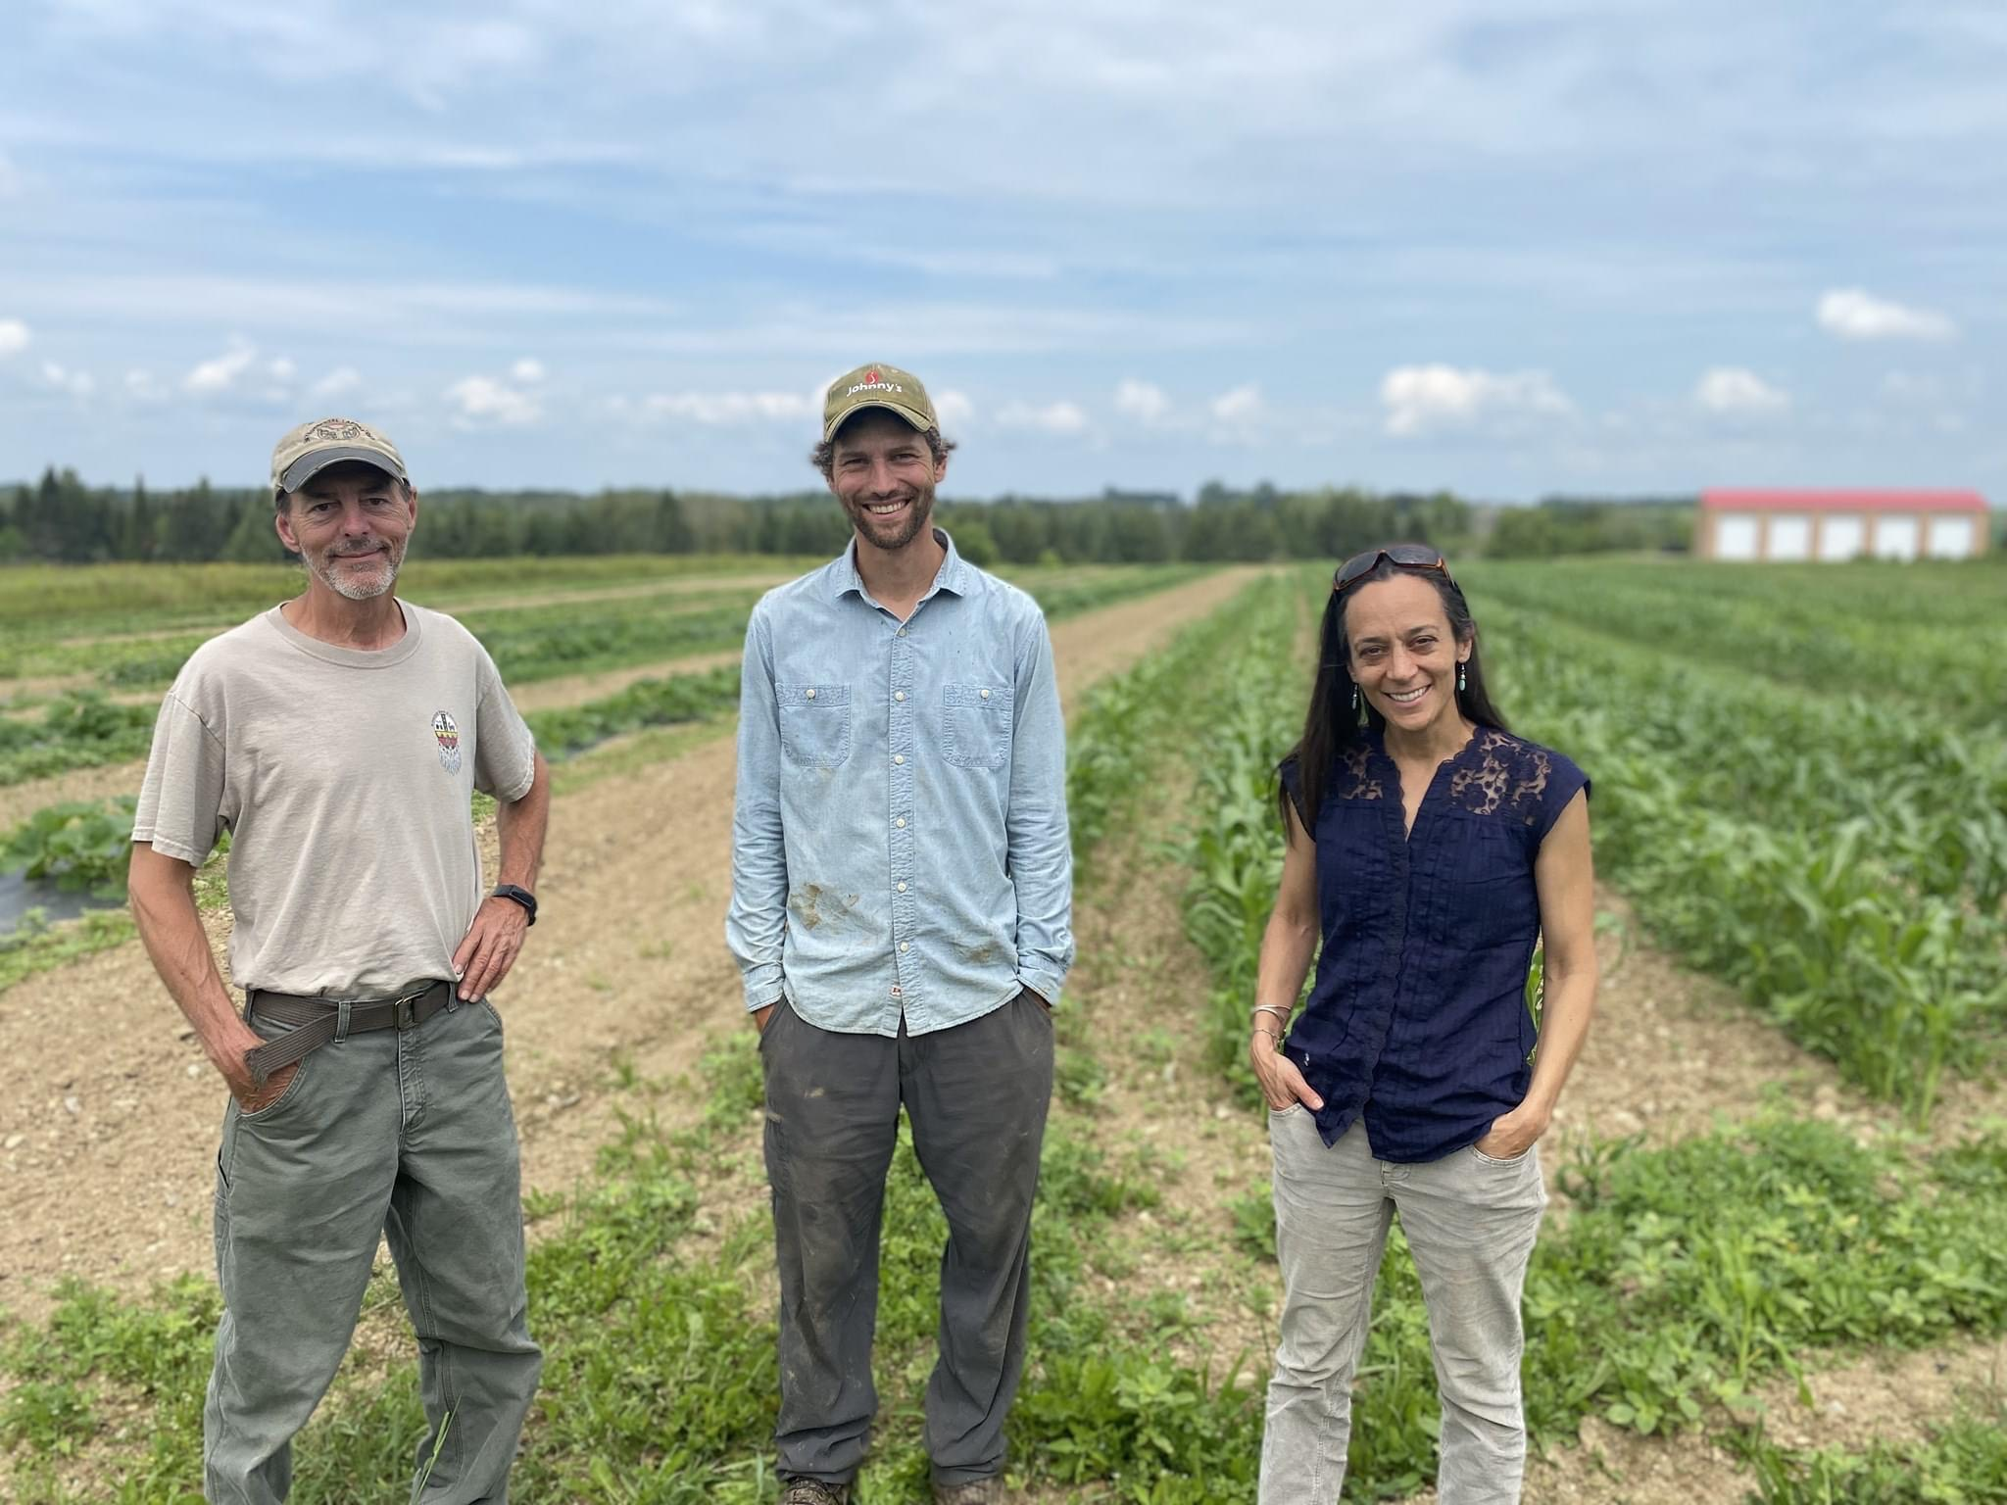
Questions?
Visit
FeedingMaine.org
Presenters
Kay Gray, Director of Sourcing
kgray@gsfb.org
Khadija Ahmed, Community Impact Manager
kahmed@gsfb.org
Nancy Perry, Senior Sourcing Manager
nperry@gsfb.org
Meg Taft, Director of Equity, Diversity & Inclusion
mtaft@gsfb.org
Photo Credit: Meg Crowder
CRF Grantee Mic Mac Farms, Brook Trout Fish Hatchery at the farm raising brook trout for tribal communities

